Slide 1
Computer Vision Bootcamp
Python & OpenCV

Slide 2
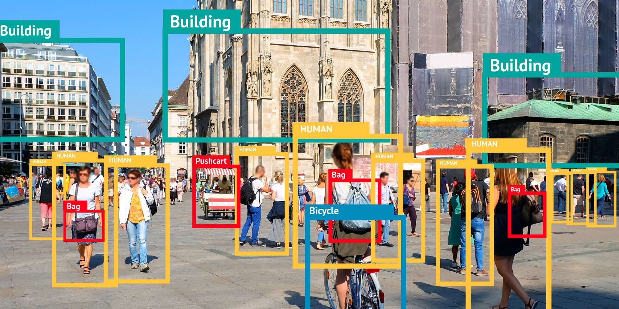
Computer Vision Algorithms

Slide 3
Computer Vision Algorithms
object detection
algorithms
(!!!)
Viola-Jones
face detection
algorithm
Convolutional Neural
Networks (CNNs)
related algorithms
2005
2015
2001
Histogram of Oriented
Gradients (HOG)
face detection
algorithm
2012
R-CNNs, Fast-CNNs
SSD and YOLO
came to be with
other helpher methods
(selective search)

Slide 4
Computer Vision Algorithms
[[1,1,1]
[0,1,0]
[0,1,0]]
this is the image we want
to process
we transform the image into a
two-dimensional array of pixel intensities
The main problem of computer vision is that we have to
preprocess the image and turn it into numerical values
→ machine learning and AI related approaches
can handle numerical data exclusively

Slide 5
Computer Vision Algorithms
The main problem of computer vision is that we have to
preprocess the image and turn it into numerical values
→ grayscale images: each pixel typically consists of
8 bits (1 byte) for grayscale images
There are 256 possible grayscale colors
→ color images: each pixel typically consists of
24 bits (3 byte) for color images (RGB components)
There are ~ 16 million colors

Slide 6
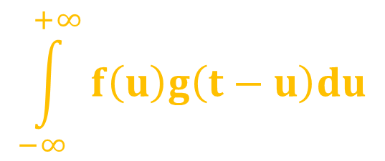
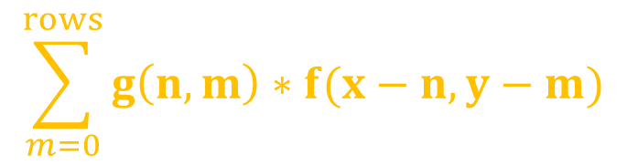
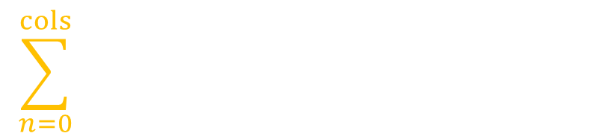
Computer Vision Algorithms
$$\int_{−∞}^{+∞}{f\left(u\right)g\left(t−u\right)du}$$
(f ● g)(t) =
convolutional
operation
In image processing convolution is the process of adding each element of the image
to its local neigbors - weighted by the kernel
image → matrix representation
kernel (feature detector or filter) → another matrix
Convolution: matrix operation - we have to multiply values
$$\sum_{n=0}^{cols}{ }$$
$$\sum_{m=0}^{rows}{g\left(n,m\right)∗f(x−n,y−m)}$$
f(x,y) ● g(x,y) =

Slide 7
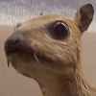
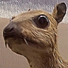
Computer Vision Algorithms
Feature detectors are represented as matrixes
~ helps to detect the relevant features in a given image
This is the sharpen kernel: it makes the given image more sharp
→ increase the pixel intensity of the given pixel
→ reduce the pixel intensity of neigbor pixels
0
-1
0
-1
5
-1
0
-1
0
the original image
image after applying
the sharpen kernel

Slide 8
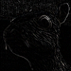
Computer Vision Algorithms
Feature detectors are represented as matrixes
~ helps to detect the relevant features in a given image
This is the edge detection kernel: it can detect edges, sometimes
this is how we can end up with relevant features
→ decrease the pixel intensity of the given pixel
→ do not change the pixel intensity of neigbor pixels
0
1
0
1
-4
1
0
1
0
the original image
image after applying
the edge detector kernel

Slide 9

Computer Vision Algorithms
Feature detectors are represented as matrixes
~ helps to detect the relevant features in a given image
This is the blur kernel: it is not that useful so we do not use
this technique in convolutional neural networks
→ do not change the pixel intensity of the given pixel
→ we use the neighbor pixel intensity values as well
1
1
1
1
1
1
1
1
1
the original image
image after applying
the blur kernel

Slide 10
Computer Vision Algorithms
0
0
1
0
0
1
0
0
0
1
0
0
0
X
1
0
1
=
0
0
0
1
0
1
0
1
1
0
0
1
1
0
0
0
1
0
kernel / filter
result
image

Slide 11
Computer Vision Algorithms
0
0
1
0
0
1
0
0
1
0
1
0
0
0
X
1
0
1
=
0
0
0
1
0
1
0
1
1
0
0
1
1
0
0
0
1
0
kernel / filter
result
image

Slide 12
Computer Vision Algorithms
0
0
1
0
0
1
0
0
1
2
0
1
0
0
0
X
1
0
1
=
0
0
0
1
0
1
0
1
1
0
0
1
1
0
0
0
1
0
kernel / filter
result
image

Slide 13
Computer Vision Algorithms
0
0
1
0
0
1
0
0
1
2
0
0
1
0
0
0
X
1
0
1
=
0
0
0
1
0
1
0
1
1
0
0
1
1
0
0
0
1
0
kernel / filter
result
image

Slide 14
Computer Vision Algorithms
0
0
1
0
0
1
0
0
1
2
0
1
0
1
0
0
0
X
1
0
1
=
0
0
0
1
0
1
0
1
1
0
0
1
1
0
0
0
1
0
kernel / filter
result
image

Slide 15
Computer Vision Algorithms
0
0
1
0
0
1
0
0
1
2
0
1
0
0
1
0
0
0
X
1
0
1
=
0
0
0
1
0
1
0
1
1
0
0
1
1
0
0
0
1
0
kernel / filter
result
image

Slide 16
Computer Vision Algorithms
0
0
1
0
0
1
0
0
1
2
0
1
0
0
1
0
0
0
1
X
1
0
1
=
0
0
0
1
0
1
0
1
1
0
0
1
1
0
0
0
1
0
kernel / filter
result
image

Slide 17
Computer Vision Algorithms
0
0
1
0
0
1
0
0
1
2
0
1
0
0
1
0
0
0
1
0
X
1
0
1
=
0
0
0
1
0
1
0
1
1
0
0
1
1
0
0
0
1
0
kernel / filter
result
image

Slide 18
Computer Vision Algorithms
0
0
1
0
0
1
0
0
1
2
0
1
0
0
1
0
0
0
1
0
2
X
1
0
1
=
0
0
0
1
0
1
0
1
1
0
0
1
1
0
0
0
1
0
kernel / filter
result
image

Slide 19
Computer Vision Algorithms
0
0
1
0
0
1
0
0
1
2
0
1
0
0
1
0
0
0
1
0
2
2
X
1
0
1
=
0
0
0
1
0
1
0
1
1
0
0
1
1
0
0
0
1
0
kernel / filter
result
image

Slide 20
Computer Vision Algorithms
0
0
1
0
0
1
0
0
1
2
0
1
0
0
1
0
0
0
1
0
2
2
0
X
1
0
1
=
0
0
0
1
0
1
0
1
1
0
0
1
1
0
0
0
1
0
kernel / filter
result
image

Slide 21
Computer Vision Algorithms
0
0
1
0
0
1
0
0
1
2
0
1
0
0
1
0
0
0
1
0
2
2
0
X
1
0
1
=
0
0
0
1
0
1
1
0
1
1
0
0
1
1
0
0
0
1
0
kernel / filter
result
image

Slide 22
Computer Vision Algorithms
0
0
1
0
0
1
0
0
1
2
0
1
0
0
1
0
0
0
1
0
2
2
0
X
1
0
1
=
0
0
0
1
0
1
1
1
0
1
1
0
0
1
1
0
0
0
1
0
kernel / filter
result
image

Slide 23
Computer Vision Algorithms
0
0
1
0
0
1
0
0
1
2
0
1
0
0
1
0
0
0
1
0
2
2
0
X
1
0
1
=
0
0
0
1
0
1
1
4
1
0
1
1
0
0
1
1
0
0
0
1
0
kernel / filter
result
image

Slide 24
Computer Vision Algorithms
0
0
1
0
0
1
0
0
1
2
0
1
0
0
1
0
0
0
1
0
2
2
0
X
1
0
1
=
0
0
0
1
0
1
1
4
1
1
0
1
1
0
0
1
1
0
0
0
1
0
kernel / filter
result
image

Slide 25
Computer Vision Algorithms
0
0
1
0
0
1
0
0
1
2
0
1
0
0
1
0
0
0
1
0
2
2
0
X
1
0
1
=
0
0
0
1
0
1
1
4
1
1
1
0
1
1
0
0
1
1
0
0
0
1
0
kernel / filter
result
image

Slide 26
Computer Vision Algorithms
0
0
1
0
0
1
0
0
1
2
0
1
0
0
1
0
0
0
1
0
2
2
0
X
1
0
1
=
0
0
0
1
0
1
1
4
1
1
1
0
1
1
0
0
0
1
1
0
0
0
1
0
kernel / filter
result
image

Slide 27
Computer Vision Algorithms
0
0
1
0
0
1
0
0
1
2
0
1
0
0
1
0
0
0
1
0
2
2
0
X
1
0
1
=
0
0
0
1
0
1
1
4
1
1
1
0
1
1
0
0
2
0
1
1
0
0
0
1
0
kernel / filter
result
image

Slide 28
Computer Vision Algorithms
0
0
1
0
0
1
0
0
1
2
0
1
0
0
1
0
0
0
1
0
2
2
0
X
1
0
1
=
0
0
0
1
0
1
1
4
1
1
1
0
1
1
0
0
2
2
0
1
1
0
0
0
1
0
kernel / filter
result
image

Slide 29
Computer Vision Algorithms
0
0
1
0
0
1
0
0
1
2
0
1
0
0
1
0
0
0
1
0
2
2
0
X
1
0
1
=
0
0
0
1
0
1
1
4
1
1
1
0
1
1
0
0
2
2
2
0
1
1
0
0
0
1
0
kernel / filter
result
image

Slide 30
Computer Vision Algorithms
0
0
1
0
0
1
0
0
1
2
0
1
0
0
1
0
0
0
1
0
2
2
0
X
1
0
1
=
0
0
0
1
0
1
1
4
1
1
1
0
1
1
0
0
2
2
2
2
0
1
1
0
0
0
1
0
kernel / filter
result
image

Slide 31
Computer Vision Algorithms
0
0
1
0
0
1
0
0
1
2
0
1
0
0
1
0
0
0
1
0
2
2
0
X
1
0
1
=
0
0
0
1
0
1
1
4
1
1
1
0
1
1
0
0
2
2
2
2
0
1
1
0
0
0
1
0
0
kernel / filter
result
image

Slide 32
Computer Vision Algorithms
0
0
1
0
0
1
0
0
1
2
0
1
0
0
1
0
0
0
1
0
2
2
0
X
1
0
1
=
0
0
0
1
0
1
1
4
1
1
1
0
1
1
0
0
2
2
2
2
0
1
1
0
0
0
1
0
0
1
kernel / filter
result
image

Slide 33
Computer Vision Algorithms
0
0
1
0
0
1
0
0
1
2
0
1
0
0
1
0
0
0
1
0
2
2
0
X
1
0
1
=
0
0
0
1
0
1
1
4
1
1
1
0
1
1
0
0
2
2
2
2
0
1
1
0
0
0
1
0
0
1
1
kernel / filter
result
image

Slide 34
Computer Vision Algorithms
0
0
1
0
0
1
0
0
1
2
0
1
0
0
1
0
0
0
1
0
2
2
0
X
1
0
1
=
0
0
0
1
0
1
1
4
1
1
1
0
1
1
0
0
2
2
2
2
0
1
1
0
0
0
1
0
0
1
1
1
kernel / filter
result
image

Slide 35
Computer Vision Algorithms
0
0
1
0
0
1
0
0
1
2
0
1
0
0
1
0
0
0
1
0
2
2
0
X
1
0
1
=
0
0
0
1
0
1
1
4
1
1
1
0
1
1
0
0
2
2
2
2
0
1
1
0
0
0
1
0
0
1
1
1
2
kernel / filter
result
image

Slide 36
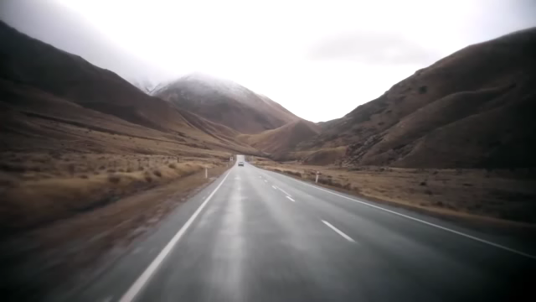
Computer Vision Algorithms – Lane Detection
One of the crucial problems of self-driving cars and computer vision is lane detection:
„A lane is part of a roadway (carriageway) that is designated to be used by
a single line of vehicles, to control and guide drivers and reduce traffic conflicts”
vehicles can avoid running into other lanes or getting off the road
→ the algorithm has to detect the lane markings
→ there are other techniques to achieve the final goal
(edge detection, transformations etc.)

Slide 37
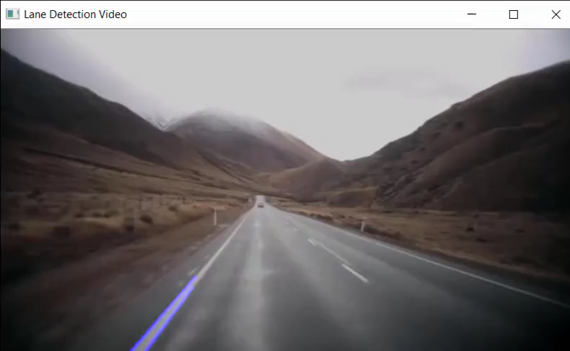
Computer Vision Algorithms – Lane Detection
One of the crucial problems of self-driving cars and computer vision is lane detection:
„A lane is part of a roadway (carriageway) that is designated to be used by
a single line of vehicles, to control and guide drivers and reduce traffic conflicts”
vehicles can avoid running into other lanes or getting off the road
→ the algorithm has to detect the lane markings
→ there are other techniques to achieve the final goal
(edge detection, transformations etc.)

Slide 38
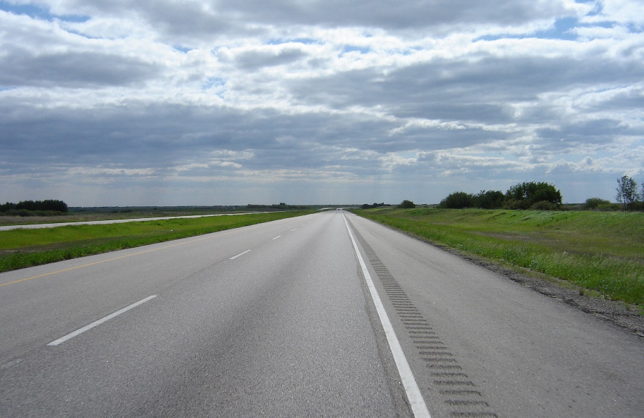
Computer Vision Algorithms – Lane Detection
One of the crucial problems of self-driving cars and computer vision is lane detection:
„A lane is part of a roadway (carriageway) that is designated to be used by
a single line of vehicles, to control and guide drivers and reduce traffic conflicts”
there is no need for the whole image: we just want to consider
the region right in front of the car (it is a good guess)
→ this is why we will create a mask and then we just have
to apply logical AND operator on the pixels

Slide 39
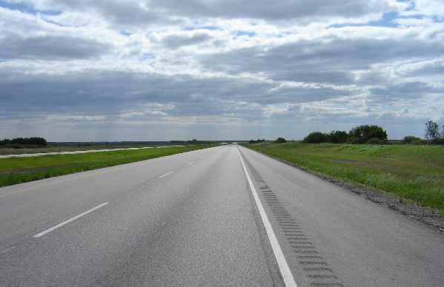

Computer Vision Algorithms – Lane Detection
One of the crucial problems of self-driving cars and computer vision is lane detection:
„A lane is part of a roadway (carriageway) that is designated to be used by
a single line of vehicles, to control and guide drivers and reduce traffic conflicts”
logical
AND
operator
=

Slide 40
Why AND Logical Operator?
x
y
x AND y
[0 0 0 0 0 0 0 0]
AND
[1 0 1 0 1 1 0 0]
0
0
0
0
1
0
1
0
0
1
1
1
[0 0 0 0 0 0 0 0]
truth table of the
AND logical operator
CONCLUSION: using black pixel intensities (0 values)
combining with AND logical operator always
yeild black pixel intensities

Slide 41
Why AND Logical Operator?
x
y
x AND y
[1 1 1 1 1 1 1 1]
AND
[1 0 1 0 1 1 0 0]
0
0
0
0
1
0
1
0
0
1
1
1
[1 0 1 0 1 1 0 0]
truth table of the
AND logical operator
CONCLUSION: using white pixel intensities (1 values)
combining with AND logical operator always
yeild the original pixel intensity

Slide 42
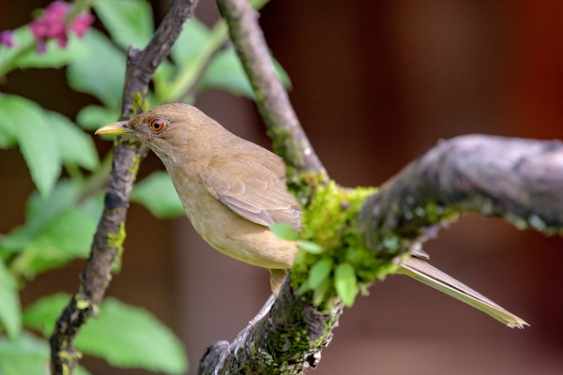
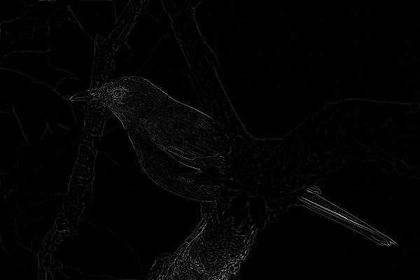
Canny Edge Detector
Canny edge detection algorithm was first published by John F. Canny in 1986
→ it can detect edges (like Laplacian edge detector)
→ it is an optimal detector: it has low error rate (can detect existing edges only), it has good
localization (detected edges and real edges are more or less the same) and
every edge is detected only once

Slide 43
Canny Edge Detector
Canny edge detection algorithm was first published by John F. Canny in 1986
1.) applying Gaussin blur to reduce noise (kernel size 5 – 5x5 matrix)
Noise is basically false edge detections in the image that are not edges in reality
and these should be removed or they will effect the edge detection process
So in order to remove any noise we must smoothen the image
2.) find the intensity gradient of the image (we have to use a kernel again – Sobel kernel)
231
236
255
100
255
255
„An image gradient is a
directional change
in the pixel intensity
or color in an image”
220
180
239
100
255
255
255
213
255
100
255
255

Slide 44
Canny Edge Detector
Canny edge detection algorithm was first published by John F. Canny in 1986
3.) non-maximum supression: it removes pixels that are not considered to be part of an edge
so only the edges (with higher probability) will remain
4.) hysteresis: the algorithm uses 2 thresholds – upper and lower threshold
→ pixel gradients higher than the upper threshold are accepted as an edge
→ pixel gradient values below the lower threshold are rejected
→ if the pixel gradient is between [lower, higher] then it will be accepted
only if it is connected to a pixel that is above the upper threshold.

Slide 45
Hough Algorithm
Hough algorithm was first published by Paul Hough in 1962
→ the Hough transform as it is universally used today was invented
by Richard Duda and Peter Hart in 1972
„generalized Hough transform”
→ so after applying the edge detection kernel: we can find lines
in the transformed image
THIS IS WHAT WE NEED FOR SHOWING THE LANES !!!
→ driving lanes are more or less straight lines on the image
we process with computer vision related algorithms

Slide 46
Hough Algorithm
y
y
y = m x + b
r = x cos δ + y sin δ
TRANSFORM
r
x
δ
x
(0,0)
(0,0)
Cartesian coordinate system is fine
but there is a huge problem:
we can not represent vertical lines
(infinite slope problem)
polar coordinate system is better
but here we have to deal with
other parameters
(maybe a bit more complex approach)

Slide 47
Hough Algorithm
y
δ
r = x cos δ + y sin δ
(r’, δ’)
r
δ
x
r
(0,0)
(0,0)
polar coordinate system is better
but here we have to deal with
other parameters
(maybe a bit more complex approach)
parameter space: in this system
every single line is a point

Slide 48
Hough Algorithm
y
there may be several lines assigned to a given point
with (x,y) coordinate
and there may be lines (red line for example) that
may cross both of the points
The parameters (x,y) or (r, δ) are the same for
the line that crosses both the points
THIS IS THE MAIN IDEA BEHIND HOUGH TRANSFORM
x
(0,0)

Slide 49
Hough Algorithm
So first of all we have to apply some kind of edge detection algorithm
(Laplacian edge detection or Canny algorithm)
→ then we have to consider all the points (r,δ) that form the edges
that we’ve found with Canny algorithm
→ if we plot the family of lines that goes through a given (r’,δ’) point
then we get sinusoid curve
Basically we create all the lines for a given (r’,δ’) point with the
constraints 0 < r < image_diagonal and 0 < δ < 2π
→ we just have to do the same operation for all the points: if the curves of 2
different points intersect that means that both points belongs to the
same line
threshold: number of intersects

Slide 50
Hough Algorithm
y
there may be several lines assigned to a given point
with (x,y) coordinate
and there may be lines (red line for example) that
may cross both of the points
The parameters (x,y) or (r, δ) are the same for
the line that crosses both the points
THIS IS THE MAIN IDEA BEHIND HOUGH TRANSFORM
x
(0,0)

Slide 51
Hough Algorithm
y
there may be several lines assigned to a given point
with (x,y) coordinate
and there may be lines (red line for example) that
may cross both of the points
The parameters (x,y) or (r, δ) are the same for
the line that crosses both the points
THIS IS THE MAIN IDEA BEHIND HOUGH TRANSFORM
x
(0,0)

Slide 52
Hough Algorithm
y
there may be several lines assigned to a given point
with (x,y) coordinate
and there may be lines (red line for example) that
may cross both of the points
The parameters (x,y) or (r, δ) are the same for
the line that crosses both the points
THIS IS THE MAIN IDEA BEHIND HOUGH TRANSFORM
x
(0,0)

Slide 53
Hough Algorithm
y
there may be several lines assigned to a given point
with (x,y) coordinate
and there may be lines (red line for example) that
may cross both of the points
The parameters (x,y) or (r, δ) are the same for
the line that crosses both the points
THIS IS THE MAIN IDEA BEHIND HOUGH TRANSFORM
x
(0,0)

Slide 54
Hough Algorithm
y
there may be several lines assigned to a given point
with (x,y) coordinate
and there may be lines (red line for example) that
may cross both of the points
The parameters (x,y) or (r, δ) are the same for
the line that crosses both the points
THIS IS THE MAIN IDEA BEHIND HOUGH TRANSFORM
x
(0,0)

Slide 55
Hough Algorithm
y
there may be several lines assigned to a given point
with (x,y) coordinate
and there may be lines (red line for example) that
may cross both of the points
The parameters (x,y) or (r, δ) are the same for
the line that crosses both the points
THIS IS THE MAIN IDEA BEHIND HOUGH TRANSFORM
x
(0,0)

Slide 56
Hough Algorithm
y
there may be several lines assigned to a given point
with (x,y) coordinate
and there may be lines (red line for example) that
may cross both of the points
The parameters (x,y) or (r, δ) are the same for
the line that crosses both the points
THIS IS THE MAIN IDEA BEHIND HOUGH TRANSFORM
x
(0,0)

Slide 57
Hough Algorithm
y
there may be several lines assigned to a given point
with (x,y) coordinate
and there may be lines (red line for example) that
may cross both of the points
The parameters (x,y) or (r, δ) are the same for
the line that crosses both the points
THIS IS THE MAIN IDEA BEHIND HOUGH TRANSFORM
x
(0,0)

Slide 58
Hough Algorithm
y
there may be several lines assigned to a given point
with (x,y) coordinate
and there may be lines (red line for example) that
may cross both of the points
The parameters (x,y) or (r, δ) are the same for
the line that crosses both the points
THIS IS THE MAIN IDEA BEHIND HOUGH TRANSFORM
x
(0,0)

Slide 59
Hough Algorithm
y
there may be several lines assigned to a given point
with (x,y) coordinate
and there may be lines (red line for example) that
may cross both of the points
The parameters (x,y) or (r, δ) are the same for
the line that crosses both the points
THIS IS THE MAIN IDEA BEHIND HOUGH TRANSFORM
x
(0,0)

Slide 60
Hough Algorithm
y
there may be several lines assigned to a given point
with (x,y) coordinate
and there may be lines (red line for example) that
may cross both of the points
The parameters (x,y) or (r, δ) are the same for
the line that crosses both the points
THIS IS THE MAIN IDEA BEHIND HOUGH TRANSFORM
x
(0,0)

Slide 61
Hough Algorithm
y
there may be several lines assigned to a given point
with (x,y) coordinate
and there may be lines (red line for example) that
may cross both of the points
The parameters (x,y) or (r, δ) are the same for
the line that crosses both the points
THIS IS THE MAIN IDEA BEHIND HOUGH TRANSFORM
x
(0,0)

Slide 62
Hough Algorithm
y
there may be several lines assigned to a given point
with (x,y) coordinate
and there may be lines (red line for example) that
may cross both of the points
The parameters (x,y) or (r, δ) are the same for
the line that crosses both the points
THIS IS THE MAIN IDEA BEHIND HOUGH TRANSFORM
x
(0,0)

Slide 63
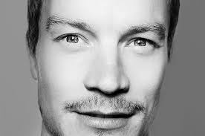
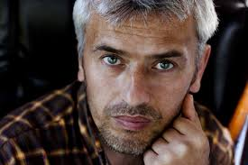
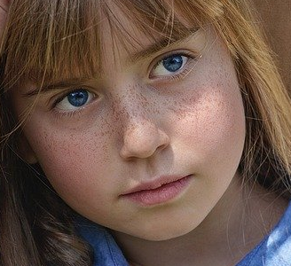
Viola-Jones Algorithm
The approach was that they created the features manually: position of nose,
position of eyes and the relations to each other
THEY FED THE FEATURES TO A SUPPORT VECTOR MACHINE
during detection: the algorithm uses Haar features
to detect the same features (eyes, noses etc.)
it is working fine with frontal faces but fails
to detect faces in any other kind
of positions and orientations

Slide 64
Histogram of Oriented Gradients (HOG)
The approach was first published by Navneet Dalal and Bill Triggs in 2005
→ this approach outperformed existing algorithms
(face detection, object detection, pedestrian detection etc.)
→ the approach uses gradients: difference in pixel intensities for
pixels right next to each other (surrounding pixels)
THE ORIENTATION OF THE GRADIENT DOES MATTER
In which direction the image is getting darker?
„Local shape information often well described by the distribution of intensity gradients or
edge directions even without precise information about the location of the edges themselves”

Slide 65
Histogram of Oriented Gradients (HOG)
the algorithm can capture edge structure (gradients) that is very
characteristic of local shapes and structures
invariant to local photometric and geometric transformations: cell rotations
and translations do not change the oriented gradient values
The orientation of faces is not that crucial any more - as we have seen
with Viola-Jones algorithm it was important !!!
using grayscale images + using blurring (Gaussian smoothing) have a negative
effect on the precision of the final classification algorithm !!!

Slide 66
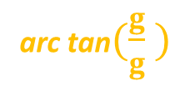
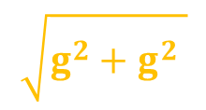
Histogram of Oriented Gradients (HOG)
-1
$$\sqrt{g^{2}+g^{2} }$$
magnitude
direction (angle)
x
y
-1
0
1
0
arc tan$(\frac{g}{g} )$
y
1
this is a horizontal
G gradient kernel
x
x
The result is very similar to Canny’s
edge detection algorithm
this is a vertical
G gradient kernel
y

Slide 67
Histogram of Oriented Gradients (HOG)
0
44
10
4
54
1
12
2
4
7
34
8
29
1
0
1
87
19
65
21
98
54
41
10
0

Slide 68
Histogram of Oriented Gradients (HOG)
0
44
10
4
54
1
12
2
4
7
34
8
29
1
0
1
87
19
65
21
98
54
41
10
0

Slide 69
Histogram of Oriented Gradients (HOG)
0
44
10
4
54
1
12
2
4
7
34
8
29
1
0
1
87
19
65
21
98
54
41
10
0

Slide 70
Histogram of Oriented Gradients (HOG)
0
44
10
4
54
1
12
2
4
7
34
8
29
1
0
1
87
19
65
21
98
54
41
10
0

Slide 71
Histogram of Oriented Gradients (HOG)
0
44
10
4
54
1
12
2
4
7
34
8
29
1
0
1
87
19
65
21
98
54
41
10
0

Slide 72
Histogram of Oriented Gradients (HOG)
0
44
10
4
54
1
12
2
4
7
34
8
29
1
0
1
87
19
65
21
98
54
41
10
0

Slide 73
Histogram of Oriented Gradients (HOG)
0
44
10
4
54
1
12
2
4
7
34
8
29
1
0
1
87
19
65
21
98
54
41
10
0

Slide 74
Histogram of Oriented Gradients (HOG)
0
44
10
4
54
1
12
2
4
7
34
8
29
1
0
1
87
19
65
21
98
54
41
10
0

Slide 75
Histogram of Oriented Gradients (HOG)
0
44
10
4
54
1
12
2
4
7
34
8
29
1
0
1
87
19
65
21
98
54
41
10
0

Slide 76
Histogram of Oriented Gradients (HOG)
0
44
10
4
54
1
12
2
4
7
34
8
29
1
0
1
87
19
65
21
98
54
41
10
0

Slide 77
Histogram of Oriented Gradients (HOG)
0
44
10
4
54
1
12
2
4
7
34
8
29
1
0
1
87
19
65
21
98
54
41
10
0

Slide 78
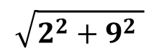
Histogram of Oriented Gradients (HOG)
0
44
10
4
54
g = | 21-19 | = 2
g = | 10-1 | = 9
magnitude = = 9.7
angle = arc tan (9/2) = 77 ֯
x
1
12
2
4
7
34
8
29
1
0
y
$$\sqrt{2^{2}+9^{2} }$$
1
87
19
65
21
98
54
41
10
0

Slide 79
Histogram of Oriented Gradients (HOG)
0
44
10
4
54
g = | 21-19 | = 2
g = | 10-1 | = 9
magnitude = = 9.7
angle = arc tan (9/2) = 77 ֯
x
1
12
2
4
7
34
8
29
1
0
y
$$\sqrt{2^{2}+9^{2} }$$
1
87
19
21
98
54
41
10
0
The angles are within the range [0,180] so-called unsigned gradients
A gradient arrow and the one 180 degrees opposite to it are considered the same (it works better)

Slide 80
Histogram of Oriented Gradients (HOG)
Finally, we have to calculate the histogram of these oriented gradients (arrows)
~ the histogram contains 9 bins corresponding to angles [0, 20, 40 … 160] in degrees
→ basically we are combining the vectors (gradients): we calculate the
distribution of the angles
→ we use unsigned gradients: it means that values larger than 160
will be transformed into the range [0,160] – with modulo operator
For example: angle 180 is 20 degree
-
-
-
-
-
-
-
-
-
-
-
-
-
-
-
-
NOTE: usually we combine 8x8 or 16x16 pixels and these
are usually called patches

Slide 81
Histogram of Oriented Gradients (HOG)
Finally, we have to calculate the histogram of these oriented gradients (arrows)
~ the histogram contains 9 bins corresponding to angles [0, 20, 40 … 160] in degrees
-
-
-
-
-
-
-
-
-
-
-
-
-
-
-
-
0
20
40
60
80
100
120
140
160

Slide 82
Histogram of Oriented Gradients (HOG)
Finally, we have to calculate the histogram of these oriented gradients (arrows)
~ the histogram contains 9 bins corresponding to angles [0, 20, 40 … 160] in degrees
-
-
-
-
-
-
-
-
-
-
-
-
-
-
-
-
0
20
40
60
80
100
120
140
160
magnitude: 2
direction (angle): 120

Slide 83
Histogram of Oriented Gradients (HOG)
Finally, we have to calculate the histogram of these oriented gradients (arrows)
~ the histogram contains 9 bins corresponding to angles [0, 20, 40 … 160] in degrees
-
-
-
-
-
-
-
-
-
-
-
-
-
-
-
-
0
20
40
60
80
100
120
140
160
magnitude: 1
direction (angle): 80

Slide 84
Histogram of Oriented Gradients (HOG)
Finally, we have to calculate the histogram of these oriented gradients (arrows)
~ the histogram contains 9 bins corresponding to angles [0, 20, 40 … 160] in degrees
-
-
-
-
-
-
-
-
-
-
-
-
-
-
-
-
0
20
40
60
80
100
120
140
160
magnitude: 4
direction (angle): 70
Since 70 degrees is half way between 60 and 80 the vote by the
pixel splits evenly into the two bins

Slide 85
Histogram of Oriented Gradients (HOG)
Finally, we have to calculate the histogram of these oriented gradients (arrows)
~ the histogram contains 9 bins corresponding to angles [0, 20, 40 … 160] in degrees
-
-
-
-
-
-
-
-
-
-
-
-
-
-
-
-
0
20
40
60
80
100
120
140
160
magnitude: 1
direction (angle): 40

Slide 86
Histogram of Oriented Gradients (HOG)
Finally, we have to calculate the histogram of these oriented gradients (arrows)
~ the histogram contains 9 bins corresponding to angles [0, 20, 40 … 160] in degrees
-
-
-
-
-
-
-
-
-
-
-
-
-
-
-
-
0
20
40
60
80
100
120
140
160
magnitude: 1
direction (angle): 40

Slide 87
Histogram of Oriented Gradients (HOG)
Finally, we have to calculate the histogram of these oriented gradients (arrows)
~ the histogram contains 9 bins corresponding to angles [0, 20, 40 … 160] in degrees
-
-
-
-
-
-
-
-
-
-
-
-
-
-
-
-
0
20
40
60
80
100
120
140
160
magnitude: 2
direction (angle): 30
Since 30 degrees is half way between 20 and 40 the vote by the
pixel splits evenly into the two bins

Slide 88
Histogram of Oriented Gradients (HOG)
Finally, we have to calculate the histogram of these oriented gradients (arrows)
~ the histogram contains 9 bins corresponding to angles [0, 20, 40 … 160] in degrees
-
-
-
-
-
-
-
-
-
-
-
-
-
-
-
-
0
20
40
60
80
100
120
140
160
magnitude: 2
direction (angle): 130
Since 130 degrees is half way between 120 and 140 the vote by the
pixel splits evenly into the two bins

Slide 89
Histogram of Oriented Gradients (HOG)
Finally, we have to calculate the histogram of these oriented gradients (arrows)
~ the histogram contains 9 bins corresponding to angles [0, 20, 40 … 160] in degrees
-
-
-
-
-
-
-
-
-
-
-
-
-
-
-
-
0
20
40
60
80
100
120
140
160
magnitude: 2
direction (angle): 130
Since 130 degrees is half way between 120 and 140 the vote by the
pixel splits evenly into the two bins

Slide 90
Histogram of Oriented Gradients (HOG)
Finally, we have to calculate the histogram of these oriented gradients (arrows)
~ the histogram contains 9 bins corresponding to angles [0, 20, 40 … 160] in degrees
-
-
-
-
-
-
-
-
-
-
-
-
-
-
-
-
0
20
40
60
80
100
120
140
160
magnitude: 1
direction (angle): 80

Slide 91
Histogram of Oriented Gradients (HOG)
Finally, we have to calculate the histogram of these oriented gradients (arrows)
~ the histogram contains 9 bins corresponding to angles [0, 20, 40 … 160] in degrees
-
-
-
-
-
-
-
-
-
-
-
-
-
-
-
-
0
20
40
60
80
100
120
140
160
We have managed to transform the region of
the image into a feature vector of 9 items
[0,1,3,2,4,0,4,2,0]

Slide 92
Histogram of Oriented Gradients (HOG)

Slide 93
Histogram of Oriented Gradients (HOG)
8px [1,4,32,10,0,1,8,76,30]
8px

Slide 94
Histogram of Oriented Gradients (HOG)
8px [6,89,3,112,3,75,2,0,1]
8px

Slide 95
Histogram of Oriented Gradients (HOG)
8px [68,110,33,12,93,135,20,60,165]
8px

Slide 96
Histogram of Oriented Gradients (HOG)
8px [8,198,3,120,45,135,2,0,5]
8px

Slide 97
Histogram of Oriented Gradients (HOG)
8px [8,18,31,20,5,51,72,1,59]
8px

Slide 98
Histogram of Oriented Gradients (HOG)
8px
8px

Slide 99
Histogram of Oriented Gradients (HOG)
8px
8px

Slide 100
Histogram of Oriented Gradients (HOG)
8px
8px

Slide 101
Histogram of Oriented Gradients (HOG)
8px
8px

Slide 102
Histogram of Oriented Gradients (HOG)
8px
8px

Slide 103
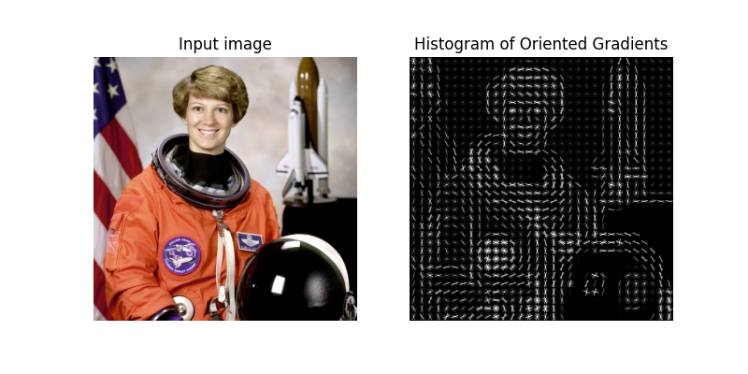
Histogram of Oriented Gradients (HOG)

Slide 104
Histogram of Oriented Gradients (HOG)
We have a huge problem: the gradient is affected by the illumination changes
(the gradients are sensitive to overall lighting)
→ if we make the image darker (dividing the pixel intensitites by 2)
then the gradients magnitude will change by half
Which means the histogram values change and the
algorithm will not work fine despite the face that it is the same image
→ we can normalize every RGB pixel with 3 components – 3 values
→ or we can use 16x16 blocks and we can normalize the
histogram directly – if we assume that a patch is 8x8
BLOCK NORMALIZATION IS NEEDED – L2 NORMALIZATION

Slide 105
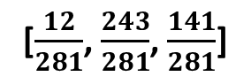
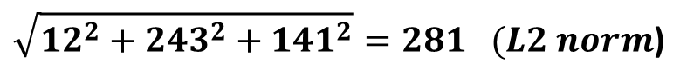
Histogram of Oriented Gradients (HOG)
We have a huge problem: the gradient is affected by the illumination changes
(the gradients are sensitive to overall lighting)
→ if we make the image darker (dividing the pixel intensitites by 2)
then the gradients magnitude will change by half
Which means the histogram values change and the
algorithm will not work fine despite the face that it is the same image
BLOCK NORMALIZATION IS NEEDED – L2 NORMALIZATION
$\sqrt{{12}^{2}+{243}^{2}+{141}^{2}}=281 (L2 norm$)
[12,243,141]
[$\frac{12}{281}$, $\frac{243}{281}$, $\frac{141}{281}$]
original pixel
intensity values
normalized pixel
intensity values

Slide 106
Histogram of Oriented Gradients (HOG)
16px
16px

Slide 107
Histogram of Oriented Gradients (HOG)
16px
16px

Slide 108
Histogram of Oriented Gradients (HOG)
16px
16px

Slide 109
Histogram of Oriented Gradients (HOG)
16px
16px

Slide 110
Histogram of Oriented Gradients (HOG)
16px
16px

Slide 111
Histogram of Oriented Gradients (HOG)
16px
16px

Slide 112
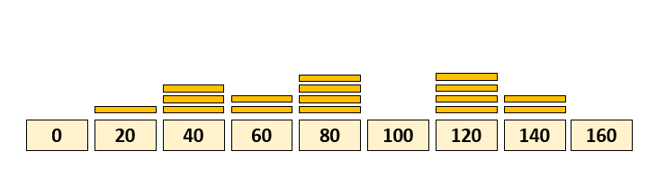
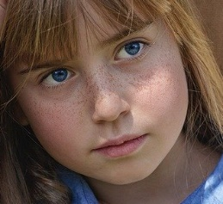
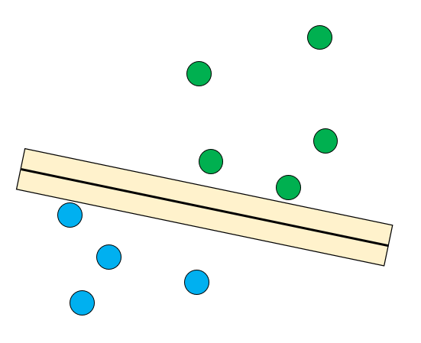
Histogram of Oriented Gradients (HOG)
we have the input images
and we need to preprocess them
(resize operation)
64 x 128 pixels
we use 8x8 patches
and calculate the gradients,
magnitude and histograms for the images
support vector classifier
(SVM)
the concatenated
normalized histogram values
are the input features
+ we need non-face images
we combine 4 patches
(16x16 pixels)
and apply L2 normalization

Slide 113
Convolutional Neural Networks (CNNs)
Convolutional neural networks have been around since the 1990s
but the processing power of computers were not good ...
→ with the advent of GPUs (after 2012) and with huge
datasets available: CNNs became the standard approach
→ it is possible to detect objects + the locations of these objects
(finding the given bounding boxes)
→ concept: we use a sliding-window as usual and we feed the small
regions of the original image into a CNN
At each step we get a prediction of what sort of object is present on the image region
THESE APPROACHES ARE VERY SLOW !!!
what is the optimal size of the sliding window
+ different aspect ratios?

Slide 114
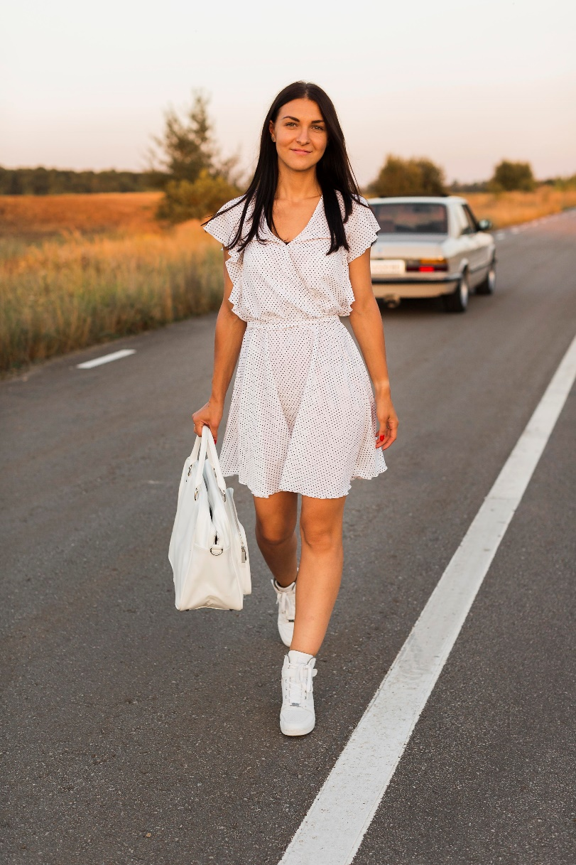
Convolutional Neural Networks (CNNs)

Slide 115
Convolutional Neural Networks (CNNs)

Slide 116
Convolutional Neural Networks (CNNs)

Slide 117
Convolutional Neural Networks (CNNs)

Slide 118
Convolutional Neural Networks (CNNs)

Slide 119
Convolutional Neural Networks (CNNs)

Slide 120
Convolutional Neural Networks (CNNs)

Slide 121
Convolutional Neural Networks (CNNs)

Slide 122
Convolutional Neural Networks (CNNs)

Slide 123
Convolutional Neural Networks (CNNs)

Slide 124
Convolutional Neural Networks (CNNs)

Slide 125
Convolutional Neural Networks (CNNs)

Slide 126
Convolutional Neural Networks (CNNs)

Slide 127
Convolutional Neural Networks (CNNs)

Slide 128
Convolutional Neural Networks (CNNs)

Slide 129
Convolutional Neural Networks (CNNs)

Slide 130
Convolutional Neural Networks (CNNs)
person
car

Slide 131
Region Based Convolutional Neural Networks (R-CNNs)
It takes an input image and produce a set of bounding boxes as output
where the each bounding box contains an object and also the category
→ it is used for object detection: cars, pedestrians, people etc.
→ the main problem with standard CNNs is that we have to consider
several regions of the image (that contains no objects at all)
R-CNNs CAN EFFECTIVELY REDUCE THE NUMBER OF ITERATIONS
→ there is an additional approach we have to use and
it is called selective search
This selective search algorithm generates the so-called region proposals
These regions are fed into a standard convolutional neural network ...
selective search
generates the roposals
for bounding boxes

Slide 132

Region Based Convolutional Neural Networks (R-CNNs)
SELECTIVE SEARCH:
→ selective search algorithm generates the proposals
for the bounding boxes (around the detected objects)
„Region proposals are just regions of the original image that we think
can potentially contain objects we are looking for”
These algorithms uses segementation: so the algorithms
group adjacent regions that are similar to each other
→ so we group pixels into a smaller number of segments
→ selective search uses a graph based approach the
so-called Felzenszwalb-Huttenlocher algorithm

Slide 133
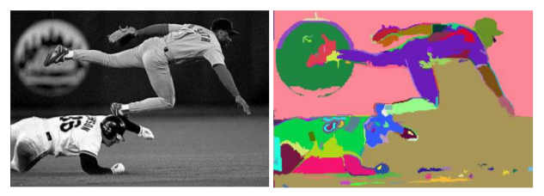
Region Based Convolutional Neural Networks (R-CNNs)
SELECTIVE SEARCH:
1.) selective search algorithm uses the result of Felzenszwalb-Huttenlocher
transform on the actual image
2.) the initial proposed regions are the segmented parts after the transformation
3.) the algorithm keeps grouping (merging) segments based on similarity
(color, texture, size and shape similarities) → final similarity is the linear
combinations of these 4 similiarities
At each iteration: larger and larger regions are added to the proposed regions

Slide 134
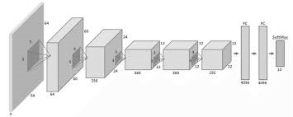
Region Based Convolutional Neural Networks (R-CNNs)
So the proposed regions will be the input of a convolutional neural network
(usually AlexNet) architecture ...
support vector classifier
(SVM)
convolutional neural network (CNN)
architectue (AlexNet)
for feature extraction
the original image with
the proposed regions
(after selective search)
AlexNet has already been trined
on different objects
(cars, pedestrians, etc.)

Slide 135
Region Based Convolutional Neural Networks (R-CNNs)
So the proposed regions will be the input of a convolutional neural network
(usually AlexNet) architecture ...
SLOW: CAN NOT BE USED IN REAL- TIME !!!
support vector classifier
(SVM)
convolutional neural network (CNN)
architectue (AlexNet)
for feature extraction
the original image with
the proposed regions
(after selective search)
AlexNet has already been trined
on different objects
(cars, pedestrians, etc.)

Slide 136
Region Based Convolutional Neural Networks (R-CNNs)
So the proposed regions will be the input of a convolutional neural network
(usually AlexNet) architecture ...
support vector classifier
(SVM)
convolutional neural network (CNN)
architectue (AlexNet)
for feature extraction
linear regression model
for the bounding boxes
the original image with
the proposed regions
(after selective search)

Slide 137
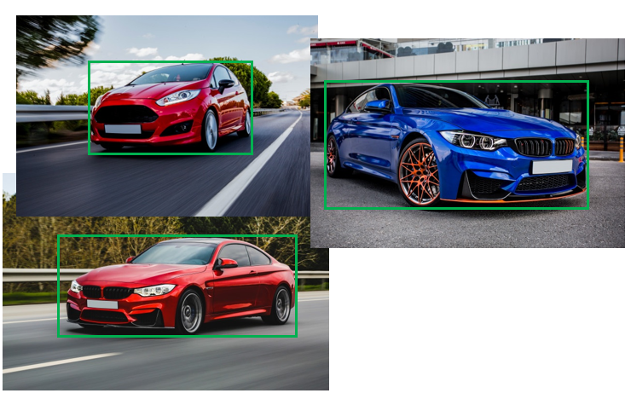
Region Based Convolutional Neural Networks (R-CNNs)
As for the bounding boxes are concerned: we need a linear regression trained
model to make sure the boxes will be in the right positions ...
at the end of the CNN let’s use a fully-connected layer with four neurons corresponding
to the top-left and bottom-right (x, y) coordinates of the bounding box
→ let’s use sigmoid activation functions and MSE (mean-squared error)
loss function (as usual when dealing with regression)
the valid bounding box we
know from the dataset
+ the prediction
(large error)
the valid bounding box we
know from the dataset
+ the prediction
(small error)

Slide 138
Fast Region Based Convolutional Neural Nets (Fast R-CNNs)
There have been several improvements made to the region based
convolutional neural network (R-CNN) approach
→ fast R-CNN architectue was first published in 2015
IT IS APPROXIMATELY 25x FASTER THAN THE ORIGINAL R-CNN !!!
→ R-CNN uses selective search and other pre-processing steps to
extract (and guess) the potential bounding boxes
(these operations ae quite computationally expensive)
→ it relies heavily on ROI pooling – that is very similar to a spatial pyramid pooling (SPP)
It’s job is to map any size input down to a fixed size output: hence the input
to the network could be of any scale (!!!)
+ this approach extracts the convolutional features of the
original image just once

Slide 139
Faster Region Based Convolutional Neural Nets
There have been several improvements made to the region based
convolutional neural network (R-CNN) approach
→ faster R-CNN architectue was first published in 2016
IT IS APPROXIMATELY 250x FASTER THAN THE ORIGINAL R-CNN !!!
→ finally it is possible to get rid of selective search: it can be done with the
help of a neural networks (region proposal networks – RPNs)

Slide 140
You Only Look Once (YOLO) Algorithm
There are several minor issues and problems with region based
convolutional neural network (and its variants)
→ very accurate but not fast: can not be used in real-time
→ we have to pre-train several components of the approach
(CNN, SVM, linear regression model for bounding boxes etc.)
YOLO ALGORITHM CAN DEAL WITH THESE ISSUES !!!
It was first published back in 2015 by Joseph Redmon, Ross Girshick etc.
→ there has been several improvements since then v2, v3, v4 ...

Slide 141
You Only Look Once (YOLO) Algorithm
There are several minor issues and problems with region based
convolutional neural network (and its variants)
→ very accurate but not fast: can not be used in real-time
→ we have to pre-train several components of the approach
(CNN, SVM, linear regression model for bounding boxes etc.)
YOLO ALGORITHM CAN DEAL WITH THESE ISSUES !!!
It was first published back in 2015 by Joseph Redmon, Ross Girshick etc.
→ there has been several improvements since then v2, v3, v4 ...

Slide 142
You Only Look Once (YOLO) Algorithm
Region based convolutional neural networks are working fine but the problem is that
they are slow to run and each individual components must be trained separately
→ with YOLO: we can train the whole model with a single neural network
object detection problem
problem of classification
and class probabilitites
bounding box localizations
SINGLE REGRESSION PROBLEM

Slide 143
You Only Look Once (YOLO) Algorithm
Region based convolutional neural networks are working fine but the problem is that
they are slow to run and each individual components must be trained separately
→ with YOLO: we can train the whole model with a single neural network
person
car
there is a 30 layers deep
convolutional neural network
(pooling, convolution, fully connected)
prediction
vectors

Slide 144
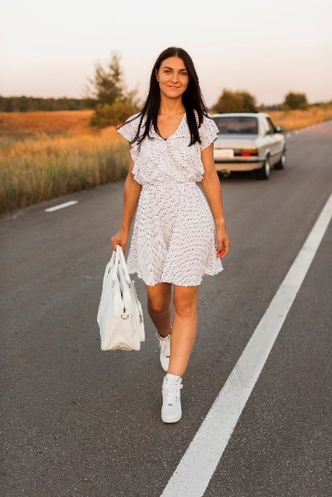
You Only Look Once (YOLO) Algorithm
INPUT AND PREPROCESSING
First of all the YOLO algorithm divides the input image up to a SxS grid
(usually 13x13 or 19x19 is the size of the grid)
every cell can detect up to B bounding boxes or parts
of bounding boxes (usually the value of B is 5)
every object has a bounding box associated with it and
every bounding box has a center (x,y) coordinate
The cell will predict the object
where the (x,y) center is located
EVERY CELL PREDICTS UP TO 5 BOUNDING BOXES
AND C CLASS PRBABILITIES !!!
What is the C class? These are the labels in the training dataset - YOLO algorithm was trained on
the PASCAL VOC dataset (images with 20 possible output classes)

Slide 145
You Only Look Once (YOLO) Algorithm
PREDICTION AND BOUNDING BOXES
The YOLO algorithm predicts the bounding boxes and probabilities as well
(so the class name and the probability of the prediction)
person 98%
so the algorithm will predict the bounding boxes with the classes
The predicted values: (x,y, w, h, confidence, class)
x: horizontal coordinate of the center of the bounding box
y: vertical coordinate of the center of the bounding box
w: width of the bounding box
h: height of the bounding box
These values are usually normalized so they are
in the range [0,1]
car 89%
relative to
the grid cell
relative to
the image size

Slide 146
You Only Look Once (YOLO) Algorithm
PREDICTION AND BOUNDING BOXES
The confidence score is 0 if there are no objects in the given cell
~ so it is basically a probability value but this is what the algorithms checks first
because if it is 0 then no need for further processing
confidence = p(object) x IOU(prediction, ground truth)
probability of
given object
intersection
over union
the training dataset has the
bounding boxes (ground truth or labels)
we know for certain

Slide 147
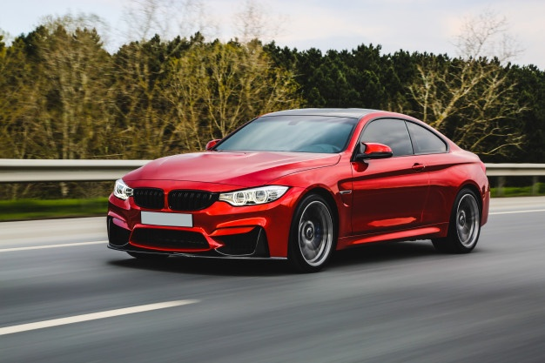
You Only Look Once (YOLO) Algorithm
PREDICTION AND BOUNDING BOXES
probability of
given object
confidence = p(object) x IOU(prediction, ground truth)
intersection
over union
ground truth (label)
area of intersection
IOU =
total area of the boxes
if it is close to 0: it means the error rate is large,
and the network makes bad predictions
prediction
if it is close to 1: it means the error rate is small,
and the network makes good predictions

Slide 148
You Only Look Once (YOLO) Algorithm
PREDICTION AND BOUNDING BOXES
probability of
given object
confidence = p(object) x IOU(prediction, ground truth)
intersection
over union
ground truth (label)
area of intersection
IOU =
total area of the boxes
if it is close to 0: it means the error rate is large,
and the network makes bad predictions
prediction
if it is close to 1: it means the error rate is small,
and the network makes good predictions

Slide 149
You Only Look Once (YOLO) Algorithm
PREDICTION AND BOUNDING BOXES
probability of
given object
confidence = p(object) x IOU(prediction, ground truth)
intersection
over union
ground truth (label)
area of intersection
IOU =
total area of the boxes
if it is close to 0: it means the error rate is large,
and the network makes bad predictions
prediction
if it is close to 1: it means the error rate is small,
and the network makes good predictions

Slide 150
You Only Look Once (YOLO) Algorithm
PREDICTION AND BOUNDING BOXES
The number of labels or output classes may change but it is usually around 20
→ it means the network is able to detect 20 different types of objects
(cars, pedestrians, bicycles, airplanes etc.)
→ we can use the one-hot representation: one dimensional array with 20
values (zeros and ones accordingly)
[1 0 0] first class (car)
[0 1 0] second class (chair)
[0 0 1] third class (pedestrian)

Slide 151
You Only Look Once (YOLO) Algorithm
PREDICTION AND BOUNDING BOXES
the YOLO algorithm only predicts one set of class probabilities per cell
regardless of the number of bounding boxes
We have to reduce the size of the cells if it is a problem to make sure
every cell detects a single object present on the image !!!
so what is the total number of predictions?
S x S x ( B x predicted_vector_size ) + S x S x C
every cell can predict
at most 5 bounding boxes
(every bounding box have several paraemters)
number of
cells
every cell predicts
an output class

Slide 152
You Only Look Once (YOLO) Algorithm
PREDICTION AND BOUNDING BOXES
the YOLO algorithm only predicts one set of class probabilities per cell
regardless of the number of bounding boxes
We have to reduce the size of the cells if it is a problem to make sure
every cell detects a single object present on the image !!!
so what is the total number of predictions?
S x S x ( B x predicted_vector_size + C )
every cell can predict
at most 5 bounding boxes
(every bounding box have several paraemters)
THE OUTPUT IS A TENSOR WITH THIS DIMENSION
number of
cells
every cell predicts
an output class

Slide 153
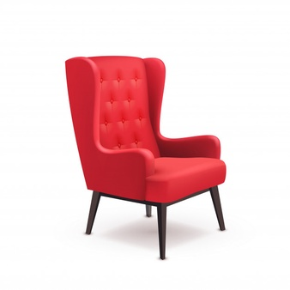
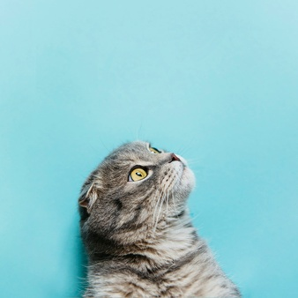
You Only Look Once (YOLO) Algorithm
TRAINING THE MODEL
the training dataset has the images with the labels
the labels are the (x,y, w, h, confidence, class) values
so the bounding box coordinates and the class label
the YOLO network makes bad predictions at the beginning so
there’s a huge error term for the bounding boxes
AFTER THE TRAINING PROCEDURE THE MODEL
IS ABLE TO DETECT OBJECTS AND DRAW BOUNDING BOXES
Why is it so fast? Because there is no pre-processing of the
input image + there is just a single forward-propagation
car
chair
cat
training
samples

Slide 154
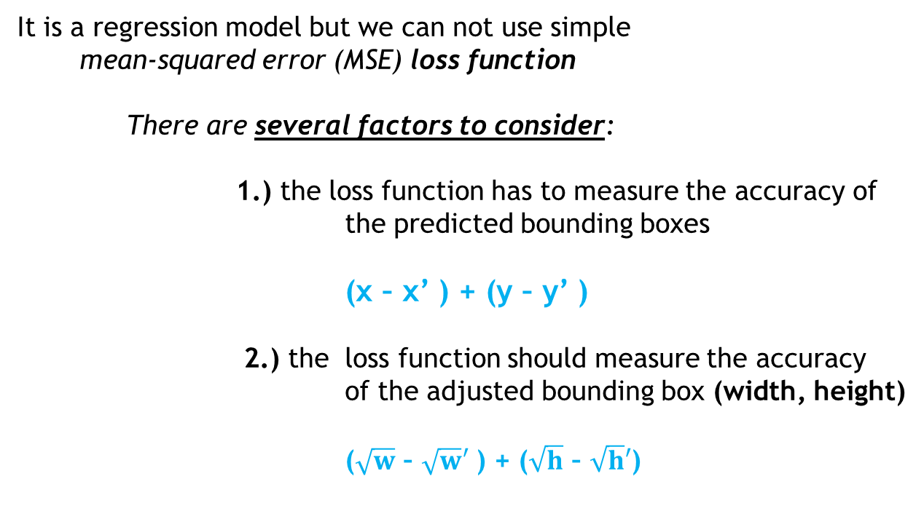
You Only Look Once (YOLO) Algorithm
TRAINING THE MODEL – LOSS FUNCTION
It is a regression model but we can not use simple
mean-squared error (MSE) loss function
There are several factors to consider:
1.) the loss function has to measure the accuracy of
the predicted bounding boxes
(x – x’ ) + (y – y’ )
2.) the loss function should measure the accuracy
of the adjusted bounding box (width, height)
($\sqrt{w}$ – $\sqrt{w}′$ ) + ($\sqrt{h}$ – $\sqrt{h}′$)
car
chair
2
2
i
i
i
i
cat
2
2
training
samples

Slide 155
You Only Look Once (YOLO) Algorithm
TRAINING THE MODEL – LOSS FUNCTION
It is a regression model but we can not use simple
mean-squared error (MSE) loss function
There are several factors to consider:
3.) the loss function has to measure the accuracy of
the confidence score
(C – C’ )
4.) the loss function should measure the accuracy
of object classification
car
chair
2
i
i
cat
training
samples

Slide 156
You Only Look Once (YOLO) Algorithm
NON-MAX SUPPRESSION
One of the most common problems of object detection algorithms
is that they have the tendency to detect one object multiple times
How to get rid of the unnecessary bounding boxes?
WITH NON-MAX SUPPRESSION APPROACH !!!
0.99
0.91
0.79
luckily we have the condifence level that has something to do
with he probability of the given bounding boxes
(the higher the value the better)

Slide 157
You Only Look Once (YOLO) Algorithm
NON-MAX SUPPRESSION
One of the most common problems of object detection algorithms
is that they have the tendency to detect one object multiple times
How to get rid of the unnecessary bounding boxes?
WITH NON-MAX SUPPRESSION APPROACH !!!
0.99
0.91
0.79
1.) the algorithms considers the bounding box with the
highest probability value
2.) the algorithm consider all the other bounding boxes and
suppress the ones that have high IOU value with the
selected one

Slide 158
You Only Look Once (YOLO) Algorithm
NON-MAX SUPPRESSION
One of the most common problems of object detection algorithms
is that they have the tendency to detect one object multiple times
How to get rid of the unnecessary bounding boxes?
WITH NON-MAX SUPPRESSION APPROACH !!!
0.99
1.) the algorithms considers the bounding box with the
highest probability value
2.) the algorithm consider all the other bounding boxes and
suppress the ones that have high IOU value with the
selected one
We repeat these steps untill all bounding boxes have been
either selected or suppressed

Slide 159
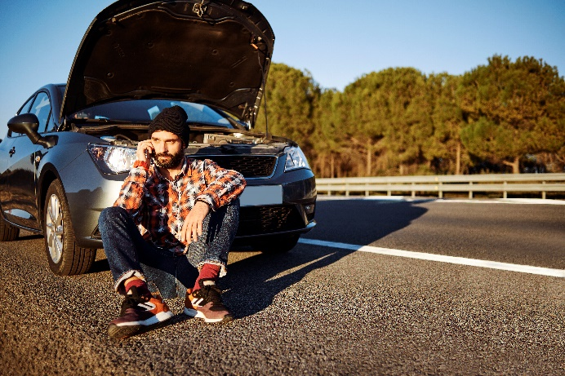
You Only Look Once (YOLO) Algorithm
ANCHOR BOXES
Every grid cell can detect a single object: but there may be some
issues with this approach ...
WHAT IF THERE ARE MULTIPLE OBJECTS IN A GRID?
→ so the center (x,y) points of both the
objects lies in the same grid cell
→ we can use anchor boxes to be able to
predict and output both objects
CAR
PERSON
So we can pre-define anchor box shapes: we assume (with high probability) that the
detected objects will have different shapes
we can assign multiple
anchor boxes (shapes)
to a single grid cell

Slide 160
You Only Look Once (YOLO) Algorithm
ANCHOR BOXES
Every grid cell can detect a single object: but there may be some
issues with this approach ...
WHAT IF THERE ARE MULTIPLE OBJECTS IN A GRID?
CAR
PERSON
x
y
w
h
conf
class
this is the precition vector
when dealing with a single
anchor box
y =

Slide 161
You Only Look Once (YOLO) Algorithm
ANCHOR BOXES
Every grid cell can detect a single object: but there may be some
issues with this approach ...
WHAT IF THERE ARE MULTIPLE OBJECTS IN A GRID?
CAR
PERSON
x
y
w
h
conf
class
bounding box related info
+ confidence and class
for the first object
this is the precition vector
when dealing with 2 single
anchor boxes
y =
x
y
w
h
conf
class
bounding box related info
+ confidence and class
for the second object

Slide 162


You Only Look Once (YOLO) Algorithm
IMAGE RESIZE
We have images with arbitrary dimensions but the YOLO
model is working with 320x320 pixels images ...
SOME TREANSFORMAZION IS NEEDED
→ note: the object detection algorithm is for the
rescaled images. Bounding boxes coordinates
are for the 320x320 pixels image
→ we want to show the bounding boxes on the original
image so we have to transform !!!
We have to use width_scale and height_scale factors for
these transformations (horizontally and vertically)

Slide 163
You Only Look Once (YOLO) Algorithm
CLASS ARRAY
We can use the one-hot representation: one dimensional array with 3
values (zeros and ones accordingly)
[1 0 0] first class (car)
[0 1 0] second class (chair)
[0 0 1] third class (pedestrian)
it means that there is 15% probability that the detected
object is a car (first class), it has 70% probability that the object
is a chair (second class) and it has 15% probability that it is a pedestrian
[0.15 0.7 0.15]

Slide 164
You Only Look Once (YOLO) Algorithm
CAR
(0,0)
(x,y)
height (h)
width (w)

Slide 165
Single-Shot Multibox Detector (SSD)
It was first published in 2016 by Christian Szegedy and his colleagues
this approach is the state-of-the-art computer vision approach
for object detection (accuracy and speed)
Although there are several version of YOLO ...

Slide 166
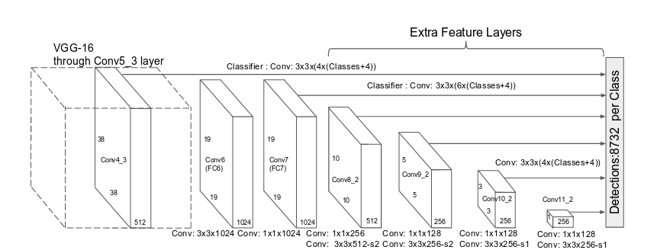
Single-Shot Multibox Detector (SSD)
car
there is a VGG16
convolutional neural network
+ 6 additional feature detector layers !!!
(NO FULLY CONNECTED LAYER)
prediction
vectors

Slide 167
Single-Shot Multibox Detector (SSD)
Usually convolutional neural networks have pooling layers and fully connected
layers as the last part of the architecture
HERE WE DO NOT HAVE ANY OF THESE LAYERS
→ the convolutional layers will make the predictions
for the bounding boxes, localizations + object classes
→ the main idea behind SSD: several convolutional layers
make predictions (these predictions
are validated finally)
→ deep neural network that is able to extract semantic
meaning from the input image while preserving
the spatial structure of the image
(of course at a lower resolution)
backbone
a pretrained image
classification network
(feature extractor)
SSD head
several (6) convolutional
layers that produce the
output vectors

Slide 168

VGG16
It is a deep convolutional neural network architecture proposed by
K. Simonyan and A. Zisserman back in 2014
→ it is able to detect objects and classify images
→ this architecture is able to achieve even 93% accuracy on the ImageNet
dataset (cntaining more than 14 million image samples – with 1000 classes)
VGG16 is a bit better than AlexNet architeture: it replaces large kernel
filters with smaller 3x3 sized filters
slow training procedure
the weights are quite large
(~550MB)
DISADVANTAGES

Slide 169
Single-Shot Multibox Detector (SSD)
The first step is very similar to YOLO algorithm: we have to divide the original
image up to SxS grid cells
→ each grid cell is responsible for detecting objects
in that region of the image
→ there is a problem again: what if there are multiple
objects in the same region of the image?
→ we can use default boxes - anchor boxes
(these are pre-defined boxes)

Slide 170
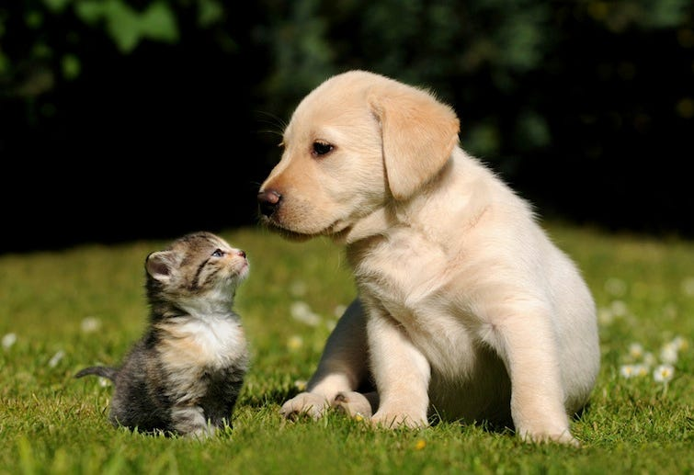
Single-Shot Multibox Detector (SSD)
DEFAULT BOXES – ANCHOR BOXES
SSD algorithm makes an assumption about the sizes and orientations
of the default boxes (we can learn about these from the training dataset)
there are patterns for the aspect ratios and sizes
of bounding boxes
pedestrians, cups etc.
have these types of
bounding box shapes
airplanes, TVs etc.
have these types of
bounding box shapes

Slide 171
Single-Shot Multibox Detector (SSD)
DEFAULT BOXES – ANCHOR BOXES
SSD algorithm makes an assumption about the sizes and orientations
of the default boxes (we can learn about these from the training dataset)
there are patterns for the aspect ratios and sizes
of bounding boxes
we assign 6 different types of bounding boxes
to every single grid cell (different aspect ratios)
DURING THE TRAINING PROCEDURE THE ALGORITHM
WILL CHOOSE THE BEST ONE !!!

Slide 172
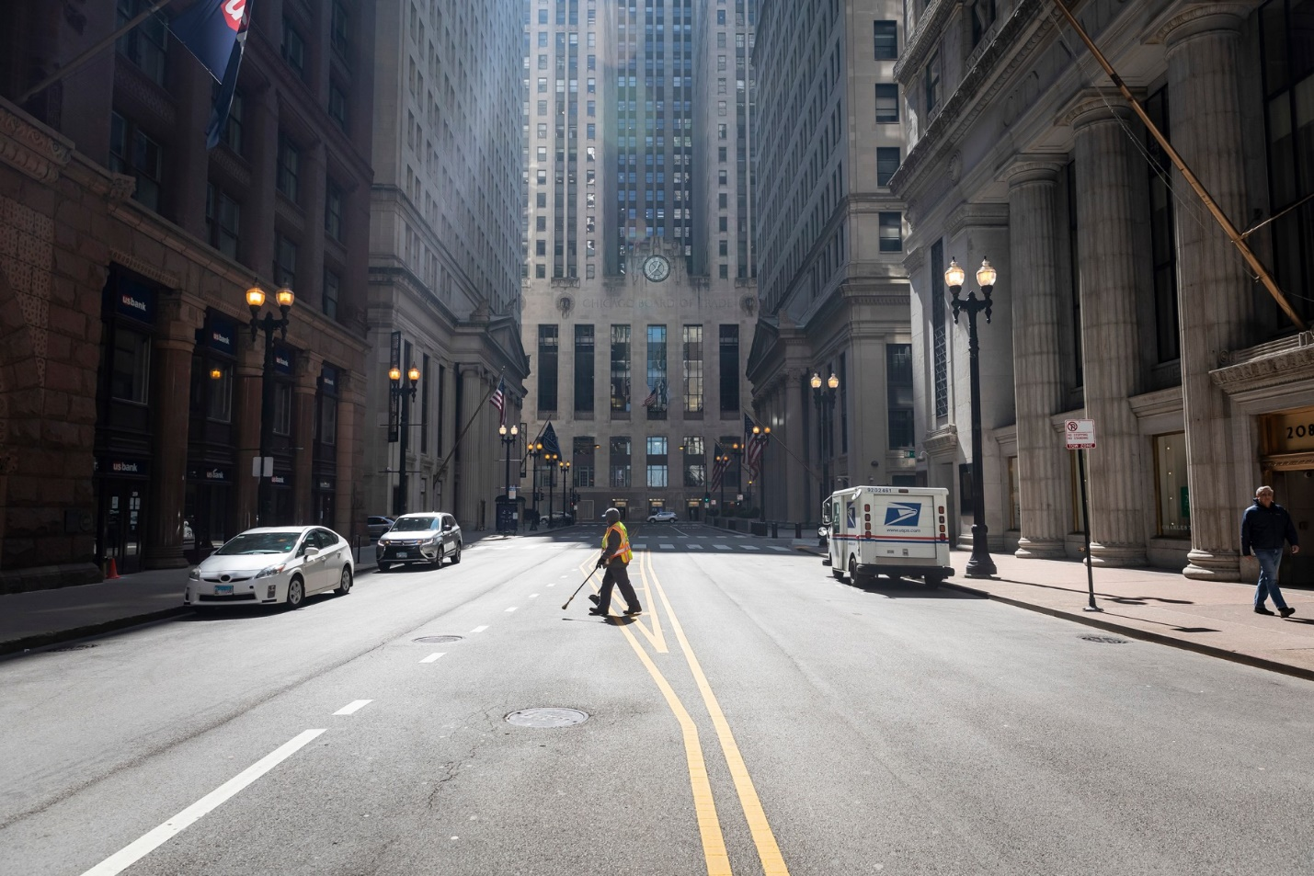
Single-Shot Multibox Detector (SSD)
DEFAULT BOXES – ANCHOR BOXES
SSD algorithm makes an assumption about the sizes and orientations
of the default boxes (we can learn about these from the training dataset)

Slide 173
Single-Shot Multibox Detector (SSD)
DEFAULT BOXES – ANCHOR BOXES
SSD algorithm makes an assumption about the sizes and orientations
of the default boxes (we can learn about these from the training dataset)

Slide 174
Single-Shot Multibox Detector (SSD)
DEFAULT BOXES – ANCHOR BOXES
SSD algorithm makes an assumption about the sizes and orientations
of the default boxes (we can learn about these from the training dataset)
→ there are several „proposed” bounding boxes but most of them
does not even everlap with a given object
→ we dispose bounding boxes with < 0.5 IoU (Jakkard index)
→ anchor box with the highest degree of overlap with an object is responsible
for predicting that given object (class and location)
→ all objects have differnet shapes (aspect ratios etc.) this is why SSD
pre-defines different aspect ratios of the anchor boxes
„The algorithm uses a matching phase while training in order to match the given
anchor box with the bounding boxes of each ground truth object within an image”

Slide 175
Single-Shot Multibox Detector (SSD)
DEFAULT BOXES – ANCHOR BOXES
SSD algorithm makes an assumption about the sizes and orientations
of the default boxes (we can learn about these from the training dataset)
a shape offset relative to the default box coordinates
the algorithm will
find the bounding box
that is the most similar
to the detected object

Slide 176

Single-Shot Multibox Detector (SSD)
DEFAULT BOXES – ANCHOR BOXES
SSD algorithm makes an assumption about the sizes and orientations
of the default boxes (we can learn about these from the training dataset)
dx
dy
conf
class
y =
the shape offset (dx, dy) relative to
the default box coordinates

Slide 177
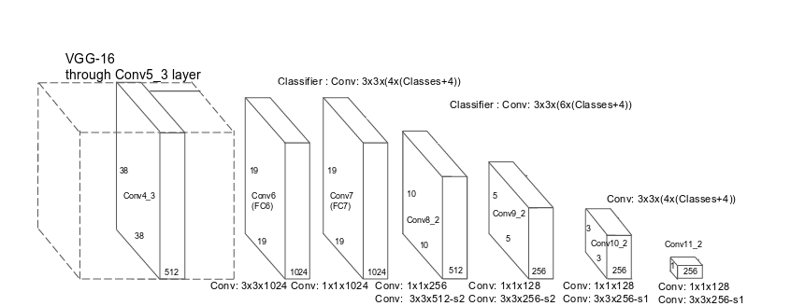
Single-Shot Multibox Detector (SSD)
FEATURE MAPS
SDD algorithm makes several predictions at different stages of the
convolutional neural network
third prediction
it uses 6 different
anchor boxes
fifth prediction
it uses 6 different
anchor boxes
first prediction
it uses 6 different
anchor boxes
second prediction
it uses 6 different
anchor boxes
sixth prediction
it uses 6 different
anchor boxes

Slide 178
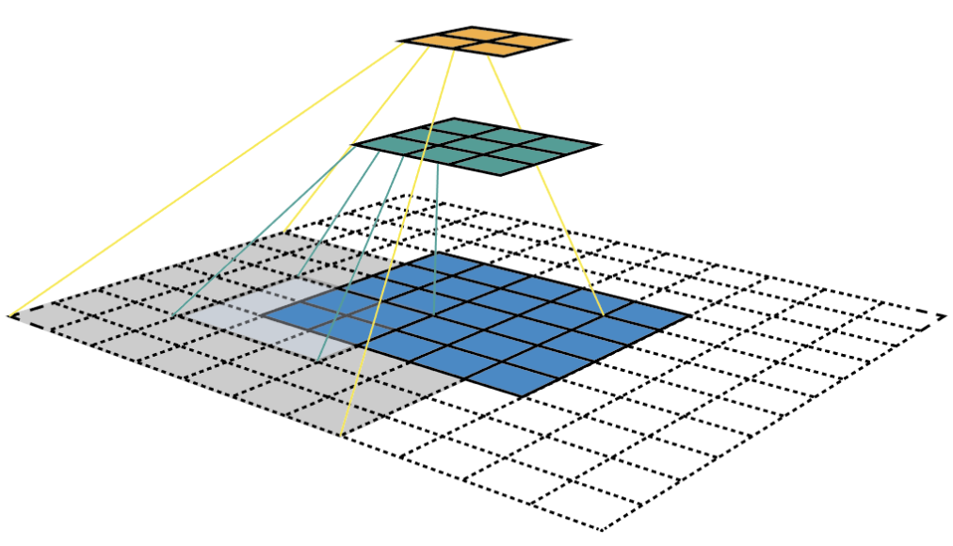
Single-Shot Multibox Detector (SSD)
FEATURE MAPS
SDD algorithm makes several predictions at different stages of the
convolutional neural network
→ the convolutional layers decrease in size progressively and
allow predictions of detections at multiple scales
→ features at different layers represent different sizes of region in the input image
The size of the image represented by a feature get larger and larger and
predictions from previous layers help in dealing with smaller objects
„The feature map is the output of one filter applied to the previous layer”

Slide 179
Single-Shot Multibox Detector (SSD)
FEATURE MAPS
SDD algorithm makes several predictions at different stages of the
convolutional neural network
„The feature map is the output of one filter applied to the previous layer”
we can detect
large objects
we can detect
normal sized objects
we can detect
smaller objects

Slide 180
Single-Shot Multibox Detector (SSD)
HARD NEGATIVE MINING
SDD algorithm generates a huge amount of bounding boxes (anchor boxes)
most of which are negative samples (so contain no objects)
→ there are way too many negative samples and just a few
positive samples (with given objects)
DISCARD MOST OF THE NEGATIVE SAMPLES
→ we do not use all the negative images: it is advised to keep a ratio
of negative to positive examples of around 3:1
→ it may seems to be a good approach to discard all negative samples
but it is not. The algorithm needs to learn about
incorrect detections as well

Slide 181
Single-Shot Multibox Detector (SSD)
DATA AUGRMENTATION
Data augmentation is a common technique in machine learning to make sure the
model will be robust to different object sizes (and orientations etc.)
→ it is also a good approach when the training dataset is too small
DATA AUGMENTATION GENERATES EXTRA TRAINING SAMPLES
→ we can generate additional training examples with
patches of the original image at different IoU ratios
+ each image is randomly flipped horizontally with
50% probability to introduce translation invariance
(for example it does not matter whether the object
is on the right or the left side of th image)

